Slide 1

NCR RIDE BOOKING
Data Analysis & Bussiness insights
Presented by:
Jyothi Polagani
AF05031560

Slide 2



NCR Ride Booking Analysis
Cards
Multi-Row card
Donut chat
Stacked column chart
Pie chart
Clustered bar chart
Table
Gauge chart
Slicers

Slide 3


OBJECTIVE
The objective of this project is to analyze NCR ride booking data to evaluate operational performance, revenue trends, customer behavior, and driver efficiency. The dashboard aims to identify key business insights such as booking distribution, cancellation patterns, vehicle-wise revenue contribution, payment preferences, and driver ratings to support data-driven decision-making and improve overall service quality.

Slide 4
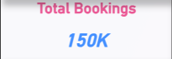
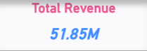
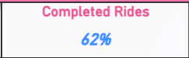
Cards
📊 Total Bookings (150K) represent the total number of ride requests made by customers during the selected period. It helps measure overall demand, customer engagement, and business activity levels.
💰 Total Revenue (51.85M) represents the total income generated from all completed rides. It indicates the company’s financial performance and overall earnings from ride services.
✅ Completed Rides (62%) represent the percentage of total bookings that were successfully fulfilled. This KPI measures service efficiency and operational performance. A higher completion rate indicates better driver availability and customer satisfaction.

Slide 5
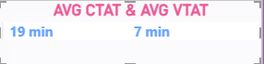
Multi-Card
⏱ Average CTAT (Customer Trip Acceptance Time)
Average CTAT (19 minutes) represents the average time taken from when a customer books a ride until the ride is accepted/confirmed. It helps in:
Measuring customer waiting time
Evaluating system efficiency
Identifying delays in ride allocation
Lower CTAT indicates faster service and better customer experience.
🚗 Average VTAT (Vehicle Trip Arrival Time)
Average VTAT (7 minutes) represents the average time taken for the assigned driver to arrive at the customer’s pickup location after accepting the ride. It helps in:
Measuring driver responsiveness
Evaluating fleet availability
Improving pickup efficiency
Lower VTAT indicates better operational performance and quicker service delivery.

Slide 6
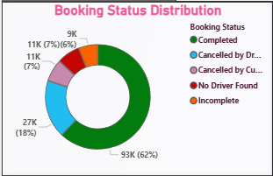

Donut chart
.
📊 Booking Status Distribution
Shows the percentage of rides that are Completed, Cancelled (Driver/Customer), or Incomplete.
It helps measure service efficiency and cancellation trends.
Higher completed rides indicate better operational performance

Slide 7
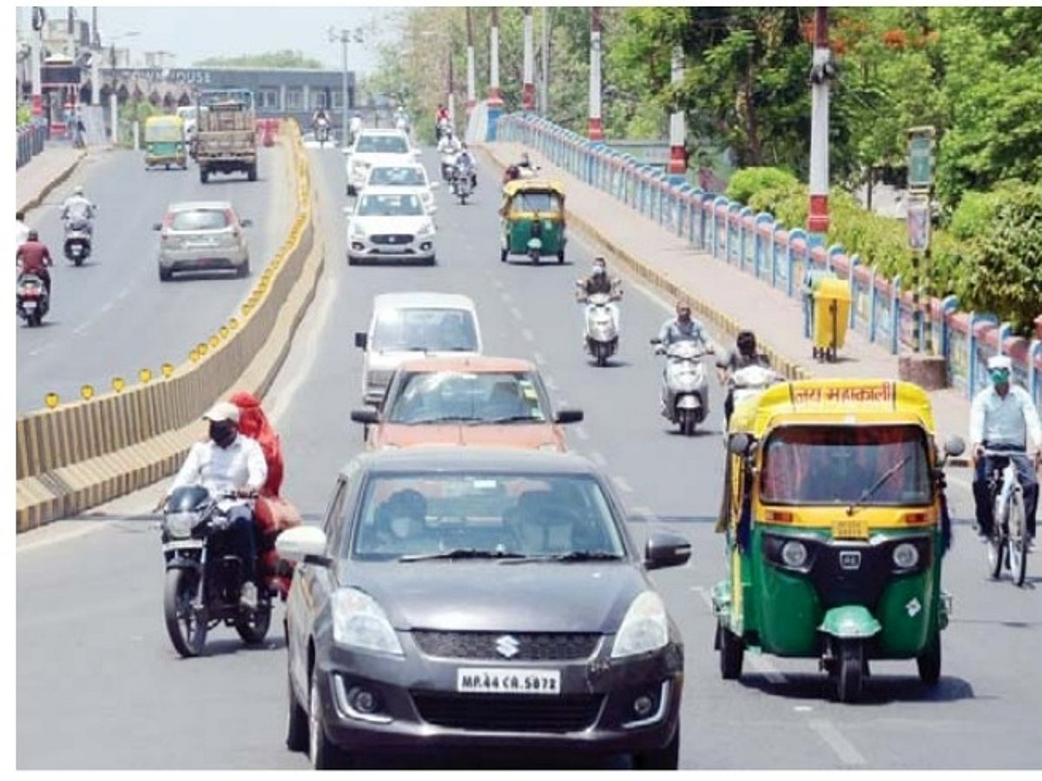
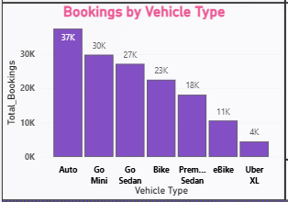
column chart
🚘 Bookings by Vehicle Type
Displays bookings across different vehicle categories.
It helps identify the most preferred vehicle type and supports fleet planning decisions.
fleet optimization ensures the right vehicle is available at the right place at the right time.

Slide 8
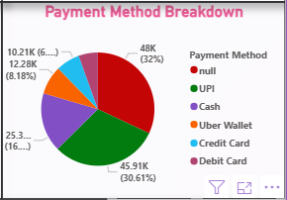
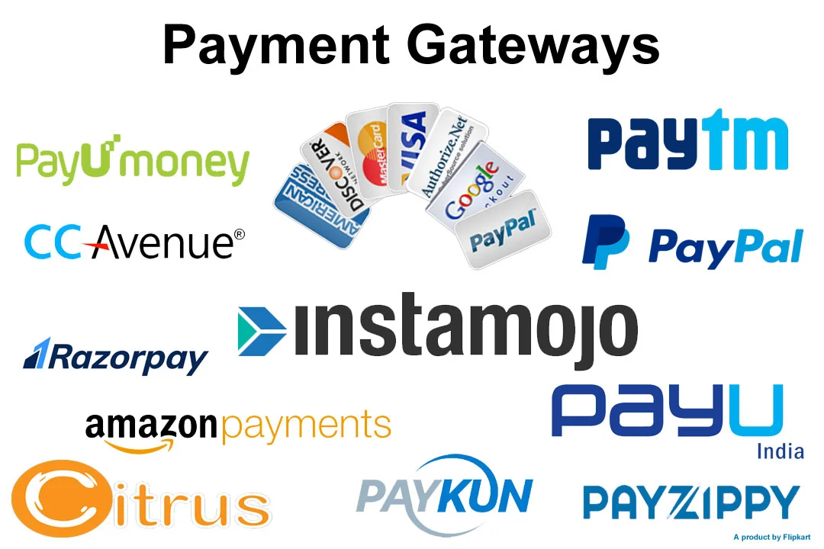
Pie chart
💳 Payment Method Breakdown
Shows the distribution of rides based on payment types such as Cash, UPI, Card, etc.
It helps understand customer payment preferences and supports digital payment strategy decisions.

Slide 9
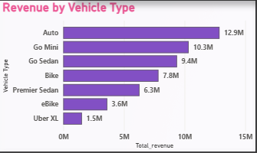

Clustered bar chart
💰 Revenue by Vehicle Type
Shows the revenue generated by each vehicle category.
Helps identify high-performing vehicle segments and supports revenue optimization decisions.

Slide 10
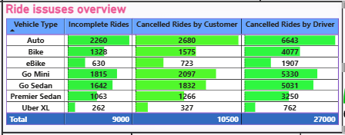
Table
⚠ Ride Issues Overview
Displays incomplete rides and cancellations by customer and driver across vehicle types.
It helps identify operational issues and highlights high driver cancellation rates that need improvement.

Slide 11
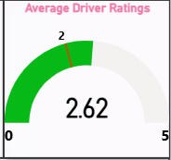
Gauge Chart
⭐ Average Driver Rating
Shows the overall average driver rating (2.62 out of 5).
Helps measure service quality and customer satisfaction levels.

Slide 12
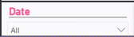
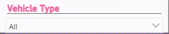
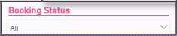
Slicers
📅 Date
Filters dashboard data based on selected time period. It helps analyze trends over time.
🚗 Vehicle Type
Filters data by selected vehicle category. Helps compare performance across vehicle segments.
📌 Booking Status
Filters rides based on status (Completed, Cancelled, Incomplete). Helps analyze operational efficiency and cancellations.

Slide 13

Conclusion
The NCR Ride Booking Dashboard provides an overview of operational performance, revenue generation, customer behavior, and driver efficiency.
Key Insights:
Strong overall demand with 150K total bookings
Auto segment generates the highest revenue
Driver cancellations are significantly high
Average driver rating (2.62) indicates scope for service improvement
Overall ,I understood that the analysis highlights the need to reduce cancellations, improve driver performance, and optimize fleet allocation to enhance customer satisfaction and business growth.

Slide 14
Thank you

